Slide 1

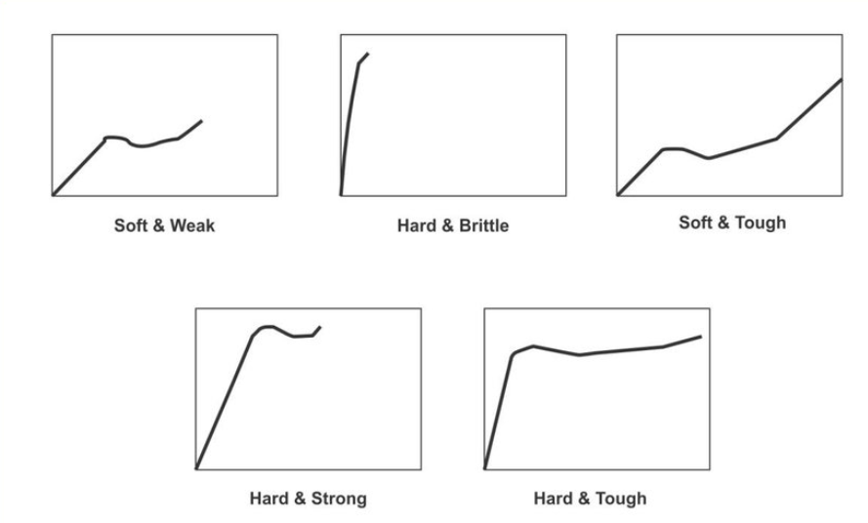
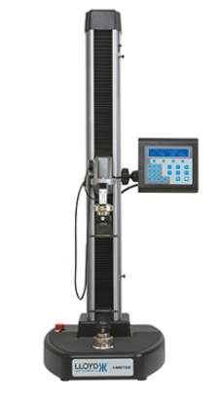
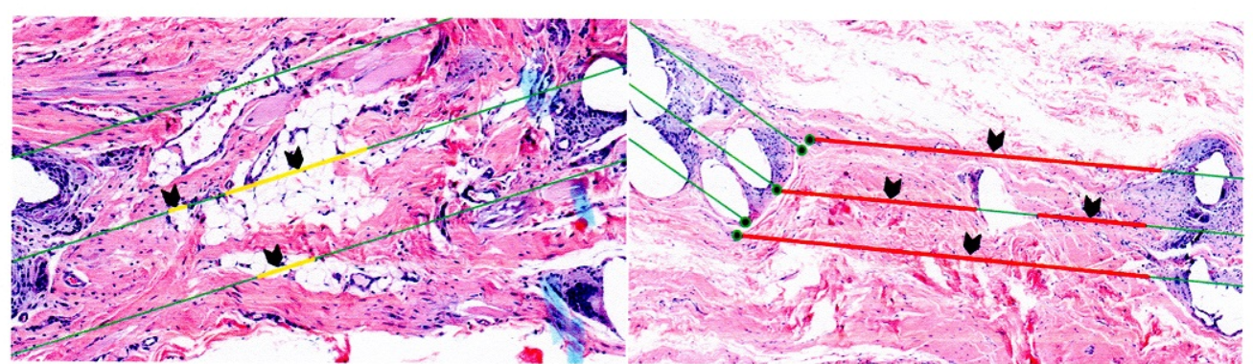
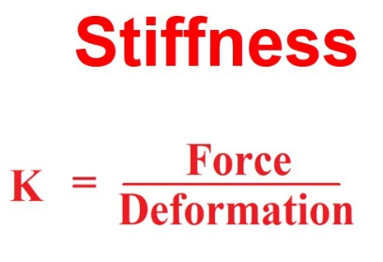
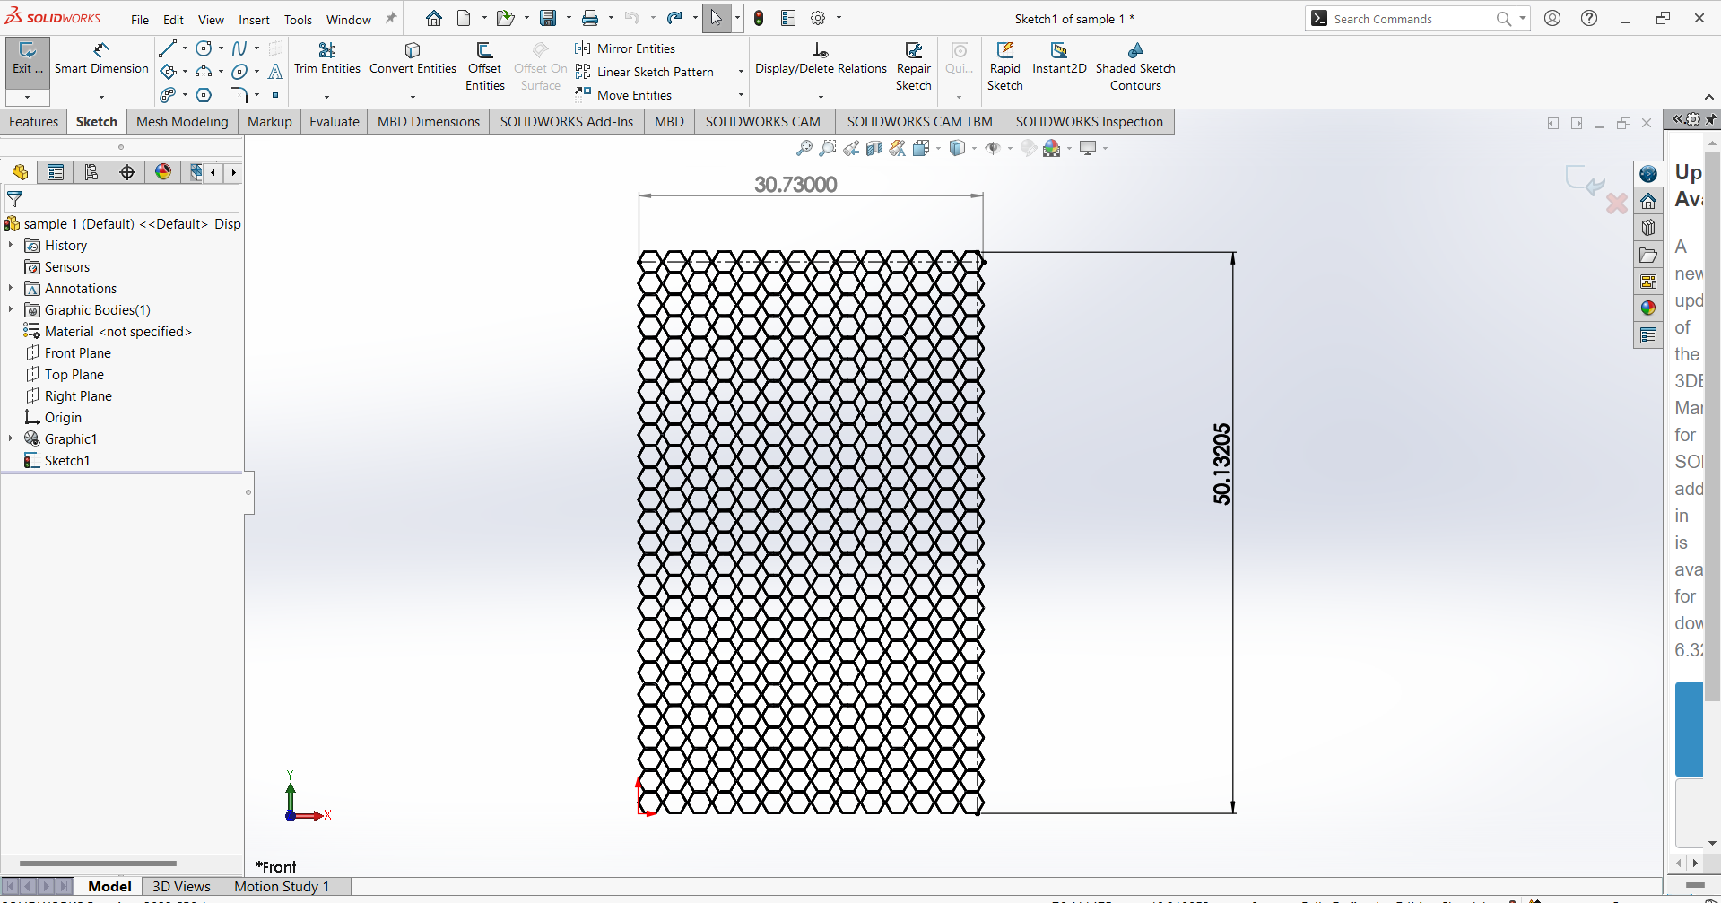
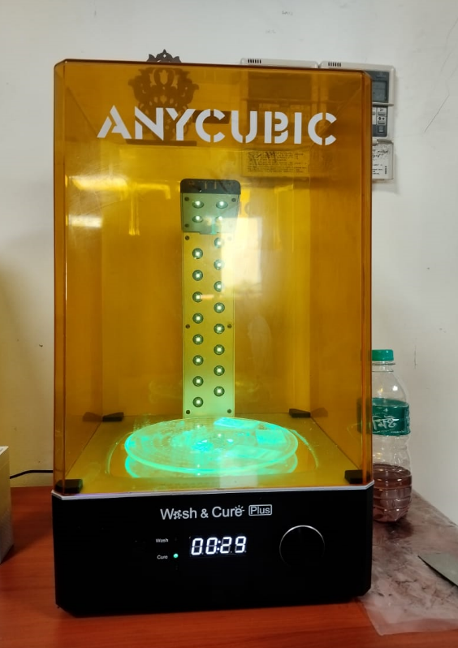
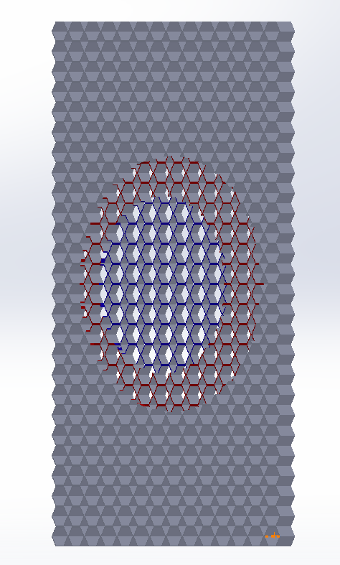
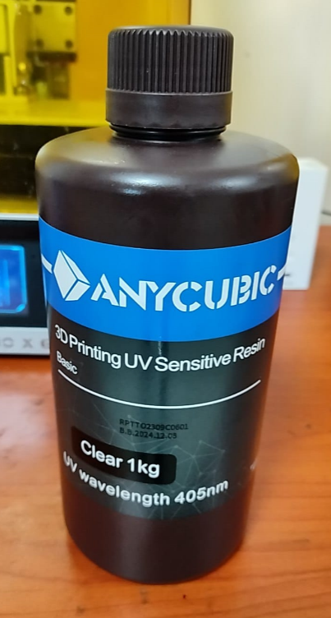
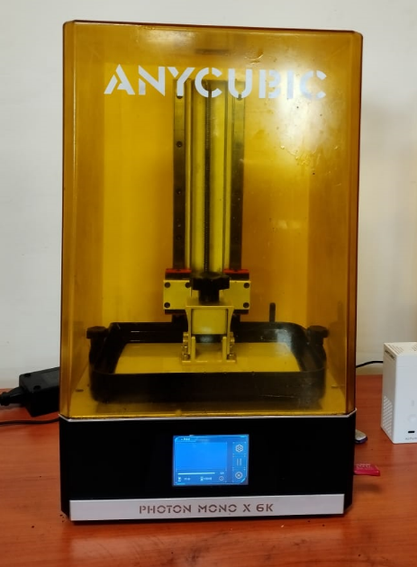
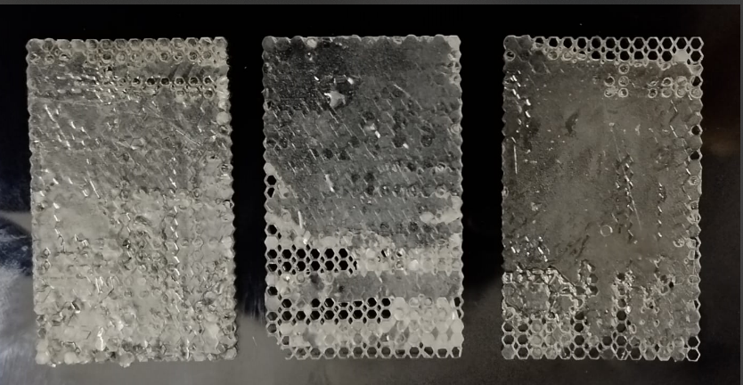
Variable Stiffness Surgical Meshes using 3D Printing UV Sensitive Resin
Mebanshem L Lyngdoh- 234103220
Shekhar verma-234103226
ME 696 – Biomedical Devices and System
l.mebanshem@iitg.ac.in, v.shekhar@iitg.ac.in
1. INTRODUCTION
3. TESTING
High stiffness meshes can exert greater pressure on surrounding tissues, increasing the risk of tissues erosion or damage overtime.
Stiffer meshes may have limited comfortability to irregular tissue contours, making it challenging to achieve optimal placement and coverage in complex surgical sites.
High stiffness meshes can infilter into the wound and there is a risk of damage.
Patients may experience discomfort or pain due to the stiffness of the mesh, particularly if it restricts normal tissue movement or causes pressure points against underlying structures.
We can use Universal Testing machine LS series.
By testing from the Universal Testing Machine , we can get the stress and strain curve.
By the stress and strain curve we can calculate stiffness.
.
Figure 1: Infiltration of surgical mesh into the wound
Figure 7: stress and strain curve
Figure 8: UTM LS series
Solution of above problem, we are going to take variable stiffness of surgical mesh instead of uniform stiffness.
4. Results
2. PREPARATION OF SAMPLE
For different thickness of sample we will get different value of stiffness.
For less thickness the stiffness also less.
First we design the sample using Solid Works.
We generates the G-CODE using ANYCUBIC WORKSHOP 3D Slicer software.
For printing the sample we used SLA PHOTON MONO X 6K machine.
We used 3D Printing UV sensitive resin for printing the sample.
Wash and Cure machine for curing the sample.
Dimensions of the sample : Length 50.13, Width 30.73 and thickness 1mm,1.5mm,2mm.
.
.
5. CONCLUSION
From this experiment we can concluded that we prefer the less stiffness of mesh in the wounded region.
It can avoid the damage of wound if the uncertainty in load .
Infiltration will not take place in wound.
.
Figure 2: CAD Model of sample
Figure 3: Wash and Cure Machine
Figure 9: Surgical mesh of variable stiffness
6. REFERENCES
Nelson, E., Grant, D. A., Grant, S. A., Hagendorn, E., Ramshaw, B., & Young, G. D. (Year). Influence of mesh structure on surgical healing in abdominal wall hernia repair. Journal Name, Volume(Issue), Page range
Flum DR, Horvath K, Koepsell. Have outcomes of incisional hernia repair improved with time? Ann Surg 2003; 23: 129-135.
Vrijland WW, van den Tol MP, Luijendink RW, Hop WC, Busschbach JJ, de Lange DC, van Geldere D, Rottier AB, Vegt PA, Ijzemans JN, Jeekel J. Randomized clinical trial of non-mesh versus mesh repair of primary inguinal hernia. BJS 2002; 89: 293-297
Figure 4: 3D Printing UV sensitive resin
Figure 5: Photon Mono X 6K
Figure 6: Prepared samples
7. ACKNOWLEDGEMENT
We would like to express our sincere gratitude to all individuals and organizations who contributed to the success of this project. Special thanks to Professor S. Kanagaraj, whose expertise and support were invaluable throughout the development and implementation of the hearing and speech assistive devices.

